Slide 1

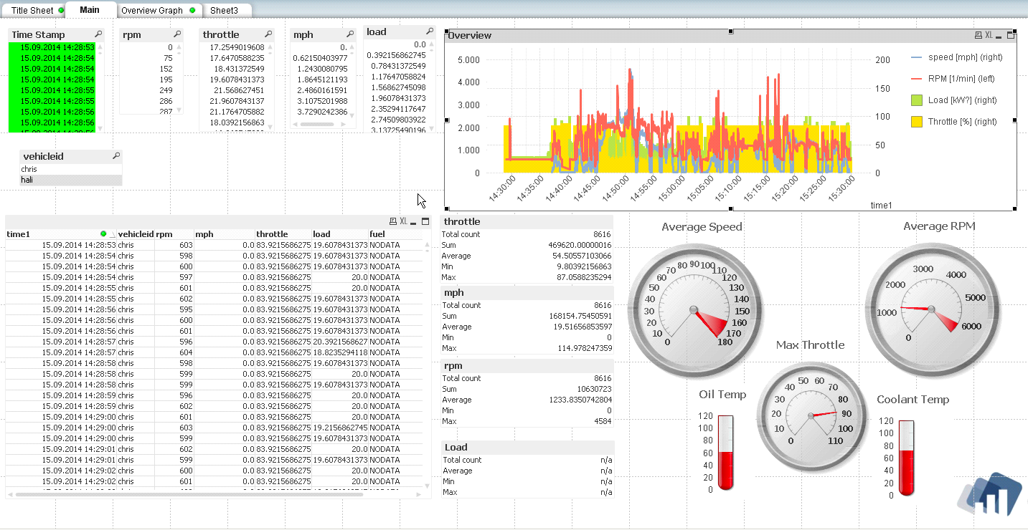





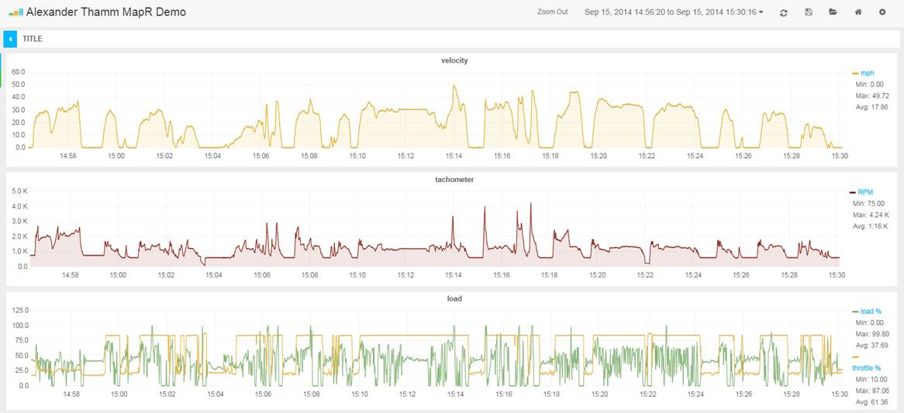


Group IoT: Connected Car on MapR Data Platform
Data Acquisition
Data Store & Analytics
Data Visualization
OBD2
QlikView
Raspberry PI
Grafana
fluentd
fluentd
real-time dashboard

